Slide 1
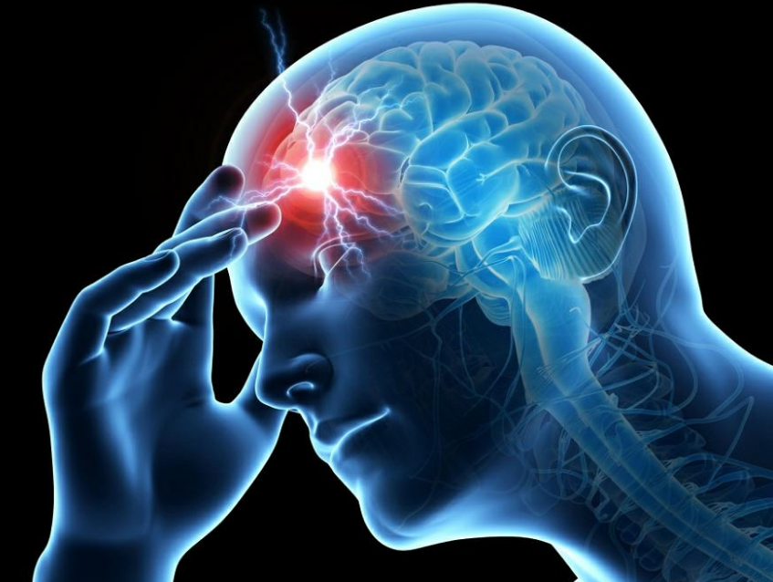
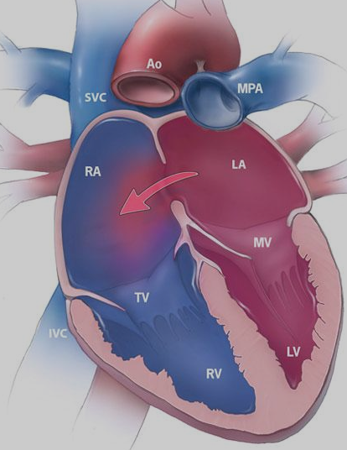
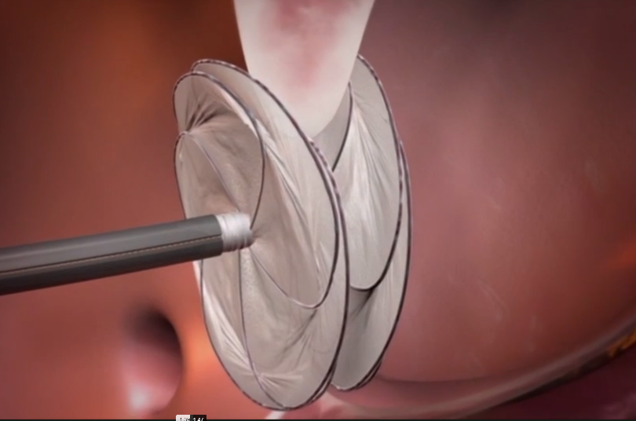
….
Is it
Is it heretical nowadays to discuss about primary prevention in atrial shunt patients? A Story from my TCD lab about a family with PFO
Dr Vesna Paunović
Special Hospital for Cerebrovascular Diseases “Sveti Sava”, Belgrade

Slide 2
InTRODUCTION
The official opinion regarding current guidelines about PFO (patent foramen ovale) or ASD (atrial septal defect) has remained inconclusive for a long time.
The latest guidelines offer the answer specifying subpopulation that would benefit the most from closure procedure RLS (right-to-left) shunt. These are patients younger than 60 years with a PFO and an embolic-appearing infarct and no other mechanism of stroke identified. *
It is still not precisely known whether PFO appears sporadically or it is familial.
Is it acceptable to do screening among unaffected siblings?
Should they be treated by primary prevention?
As stated in current guidelines, it is not recommended.
*Practice advisory update summary: Patent foramen ovale and secondary stroke prevention ,Report of the Guideline Subcommittee of the American Academy of Neurology ,Steven R. Messé, at all. First published April 29, 2020

Slide 3
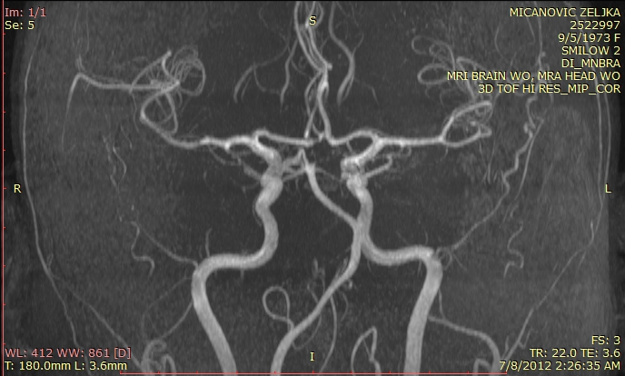
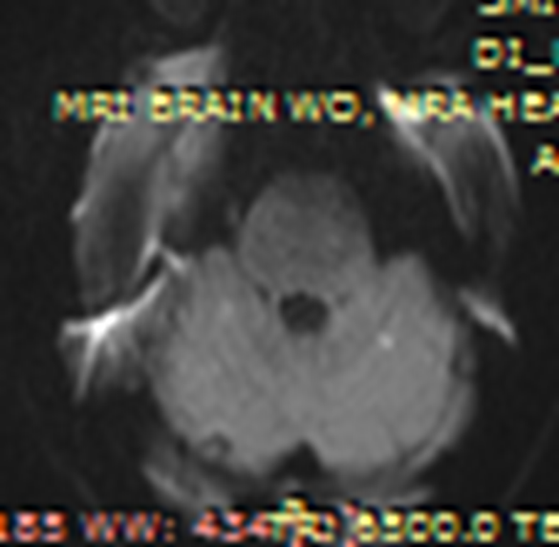
The Mother
Ten years ago, a 39-year-old female patient visited her relatives in America.
She suddenly experienced an acute-onset vomiting, a headache, vertigo, left–sided weakness.
On admission in a stroke center CTA : top of the basilar artery thrombus. Intravenous t-PA was administered to her, which led to significant clinical improvement.
The day after, MRA and MRI of the brain were performed.
thrombus in the top of the basilar artery was resolved
ischemia in the left superior cerebellar hemisphere

Slide 4
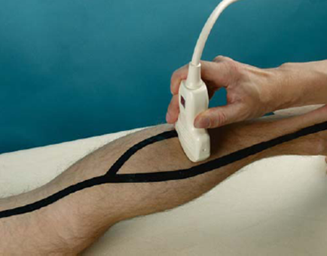
Past medical history: migraine with visual aura, varicose veins, 2 normal pregnancies
Family history: she had two maternal aunts with history of stroke in their 50s without any common risk factors for cerebrovascular disease
Examinations:-hypercoagulable panel was negative
- Doppler ultrasounds of bilateral lower extremities: no evidence of DVT ( deep venous thrombosis). We should bear in mind two circumstances:
1.)Two weeks before the ischemic stroke our patient flew from Serbia to America. The flight lasted 12 h in economy class, that means she was in a sitting position for 12 h. It represents a high risk factor for DVT, if not taken any prophylactic therapy.
2.)The sensitivity Doppler ultrasounds for calf DVT is about 60%, which indicates about 40% of false negative results of this technique. *
*Ultrasound for Lower Extremity Deep Venous Thrombosis , Multidisciplinary Recommendations From the Society of Radiologists in Ultrasound Consensus Conference ,Laurence Needleman at al ,3 Apr 2018

Slide 5
TTE( transthoracic echocardiogram ) and TEE ( transesophageal echocardiogram ) were significant for a small PFO
On discharge, the neurologic exam was normal.
After that, she returned to Serbia where she was also hospitalized.
TCD with bubble test: no occurrence of MES (micro-embolic signals) at rest,
with Vasalva maneuver the mother had 20 MES.
In fact, the patient has possible provoked DVT and PFO.
Later, she underwent transcatheter closure of PFO and after that the migraine improved.

Slide 6
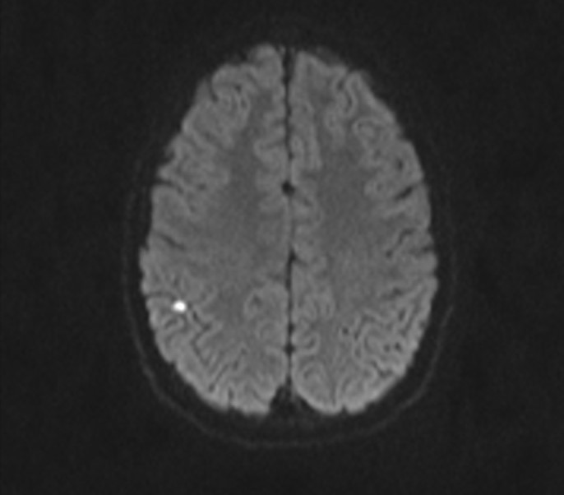
The SON
Five years later, her son, aged 16, also had a minor cryptogenic stroke (with acute-onset of left-sided weakness and paresthesia ) .
MRI-DWI : focal cortical ischemic lesions , restriction of diffusion
TEE : tunnel-shaped PFO with ASA (atrial septal aneurysm)
TCD with bubble test: no occurrence of MES at rest, with Vasalva maneuver the son had 5 MES.
Hypercoagulable panel was negative.
Past medical history : he was healthy until then.
He underwent transcatheter closure of PFO, too.
MRI-DWI focal cortical ischemic lesion , restriction of diffusion

Slide 7
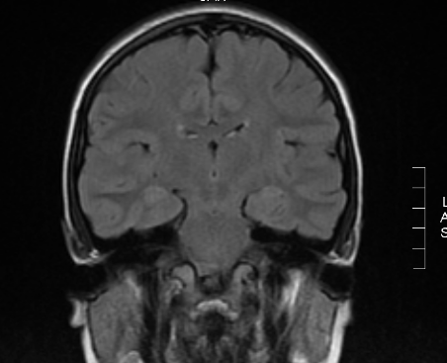
The dAughter
Two years ago, I examined the 14-year old daughter on her mother`s request due to suffering from the migraine with visual aura. Neurological exam was normal.
TCD with bubble test: 3 MES with Vasalva manouver
TTE: atrial shunt traced , left to right direction
MRI of the brain : without any lesion.

Slide 8
What to do with the healthy daughter?
She is sixteen years old now.
TCD and TTE: low grade RTL shunt
She suffers from migraine with aura without WMR (white matter lesions) on MRI.
She exercises recreationally and she has no exercise desaturation.
Her lifestyle is without high-risk activities : no scuba-diving, no mountaineering, no frequent flying, no heavy object bearing
She is too young for pregnancy planning.
It is decided not to close PFO for now.

Slide 9
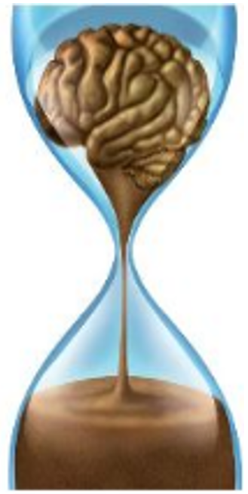
CoNCLUSION
In regard to present knowledge, atrial shunt (PFO or ASD) is not inherited. Some population based studies suggest that isolated atrial shunt is more frequent among affected patients` siblings, first-and second-degree relatives. *
The latest studies about the safety of device closure tend to introduce primary stroke prevention because PFO closure is safe and effective.
*Population-based assessment of familial inheritance and neurologic comorbidities among patients with an isolated atrial septal defect
Matthew H Steenblik ^{at} all,. Nov-Dec 2009;4(6):459-63.

